Slide 1



Capstone Project : End-to-End Data Science Project
ALBIN K A
DA DS DEC 2024
05/08/2025

Slide 2
ProjPect Overview
This capstone project explores product patterns across electronics categories using Python. It starts with web scraping and data cleaning, followed by clustering based on price and review volume. The final dataset reveals consumer trends and market segmentation, blending technical rigor with business insight.

Slide 3


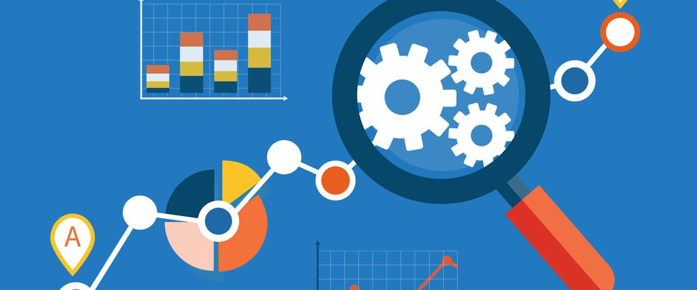
Agenda
Web Scraping
Data Cleaning
Exploratory Data Analysis (EDA)
Unsupervised Learning (Clustering)
Supervised Learning (Classification)
Hyperparameter Tuning

Slide 4
Web Scraping
Data Collection
Source of data : https:/webscraper.io
Method : web scraping with BeautifulSoup
Product data, including : Product Name ,Price ,Category ,Ratings ,Number of Reviews

Slide 5
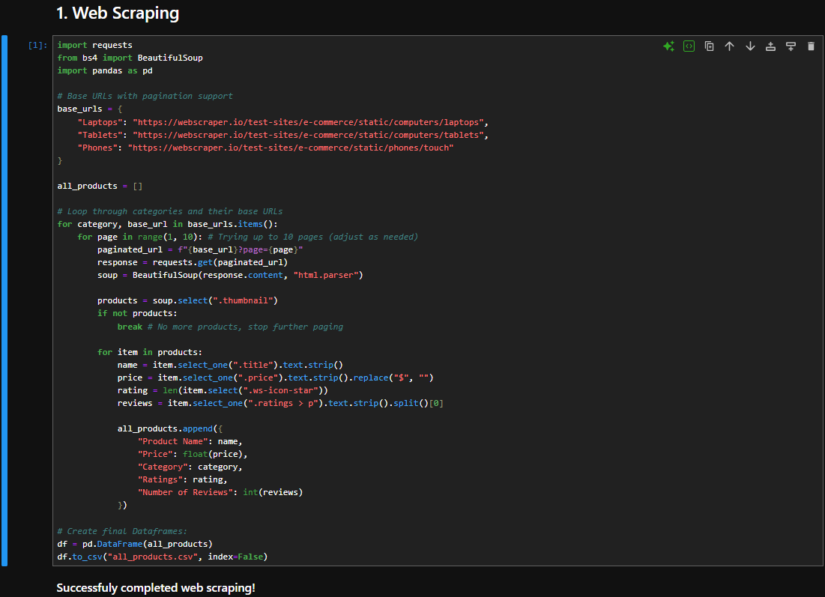

Slide 6
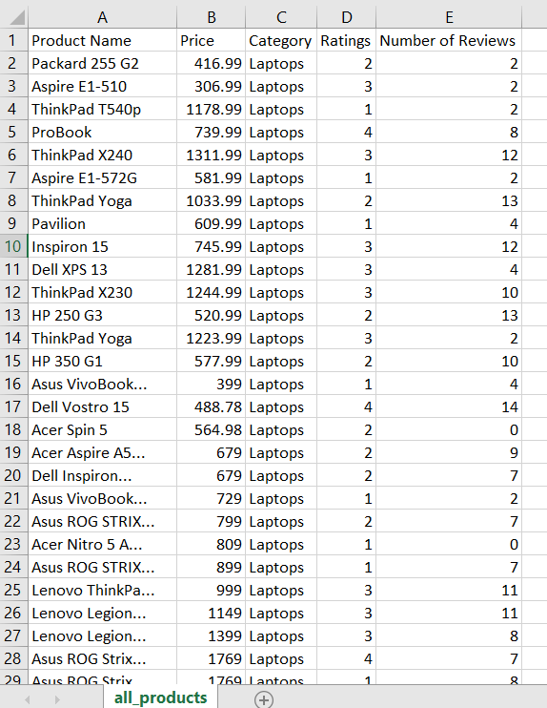

Slide 7
Data Cleaning
Load the data into a pandas DataFrame
Steps taken to clean the data (missing values, duplicates, format standardization)

Slide 8
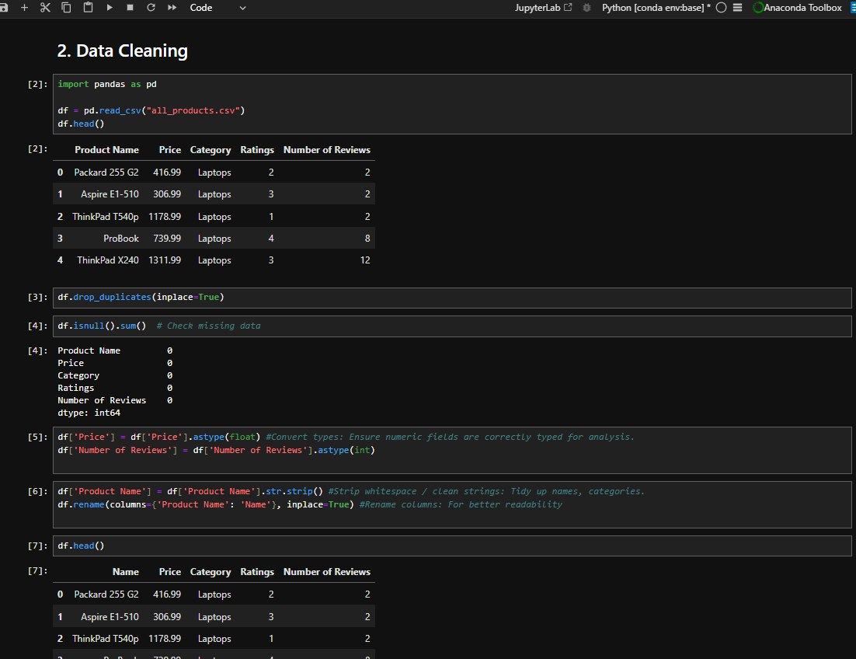

Slide 9
Exploratory Data Analysis (EDA)
df['Category'].value_counts().plot(kind='bar', title='Product Counts by Category’)
– Category wise Distribution
import seaborn as snsimport matplotlib.pyplot as plt #Price Distributionsns.histplot(df['Price'], kde=True)plt.title("Price Distribution")plt.show()
- Price Distribution
sns.boxplot(data=df, x='Category', y='Price') plt.title("Price Spread by Category")
- Price Comparisons by Category

Slide 10
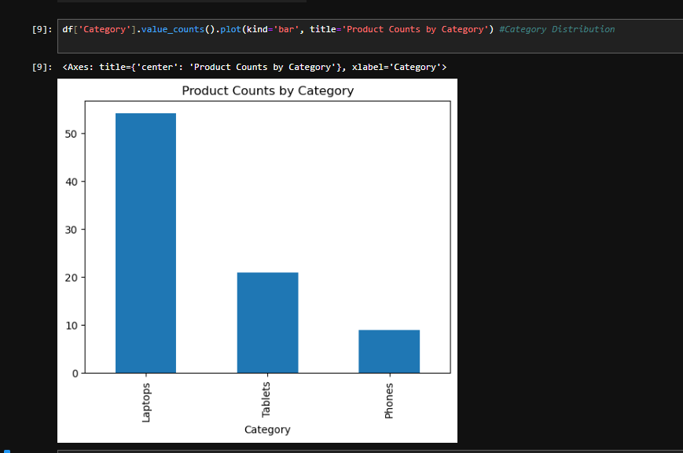
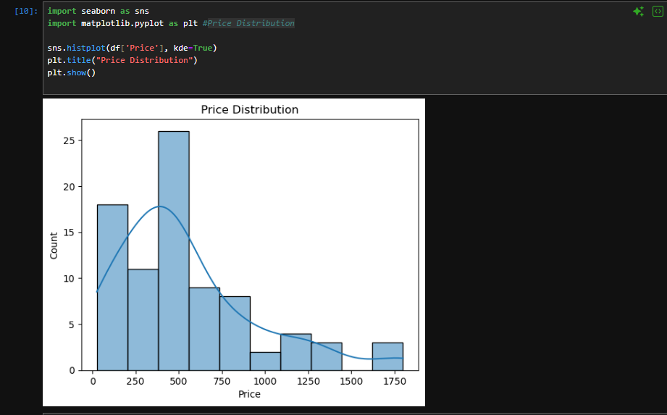
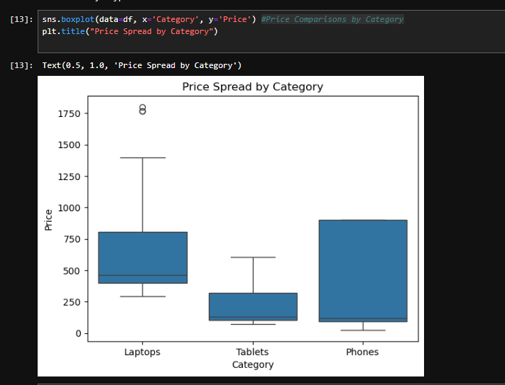

Slide 11
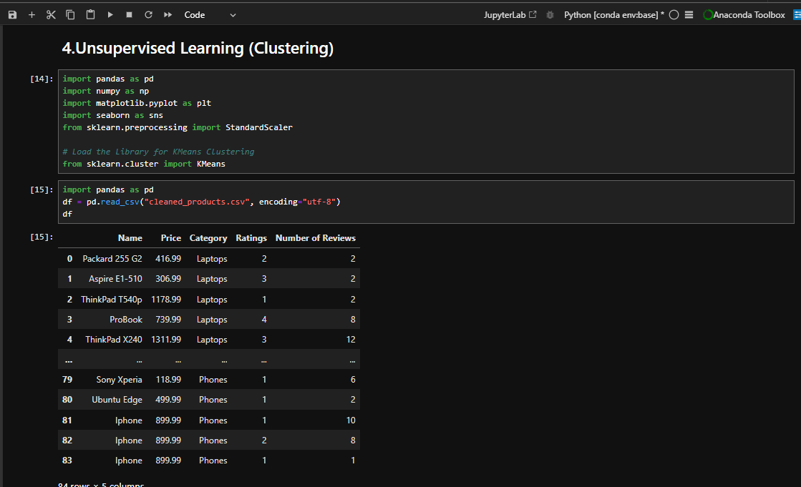
Unsupervised Learning (Clustering)

Slide 12
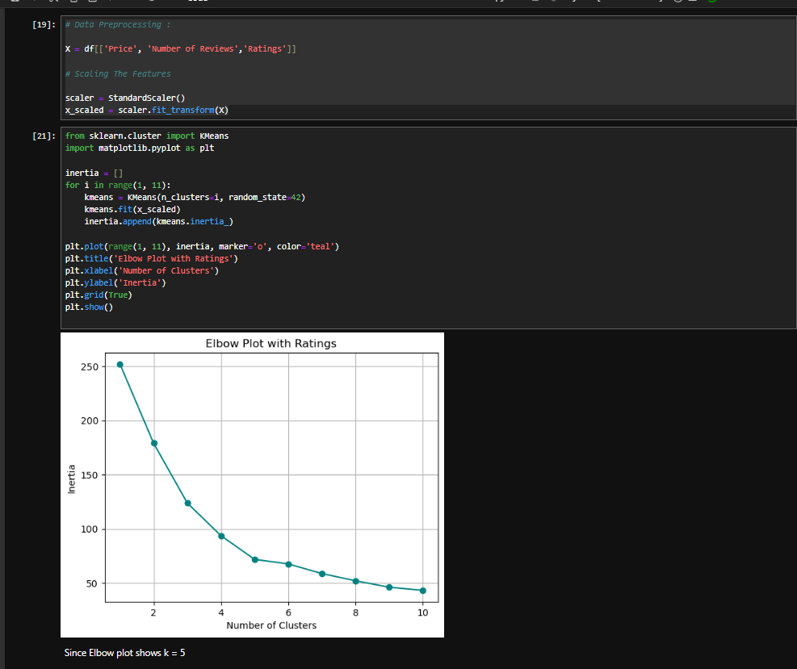

Slide 13
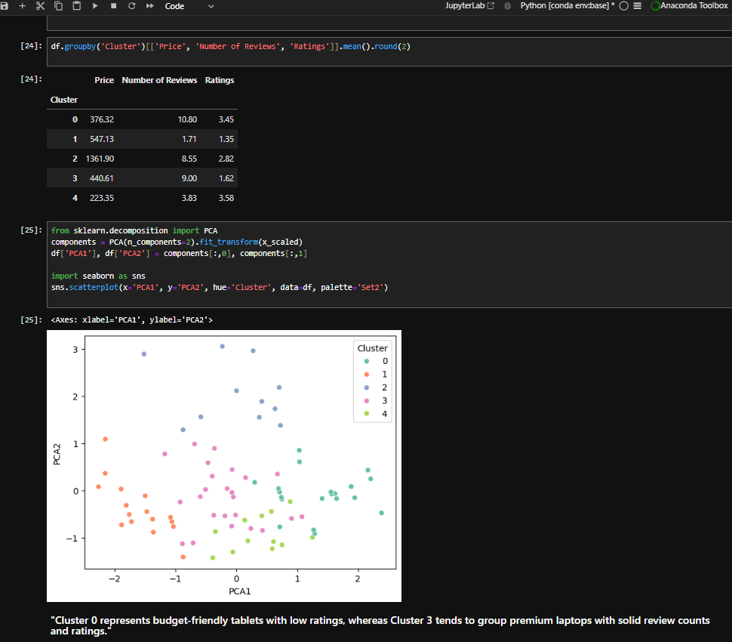

Slide 14
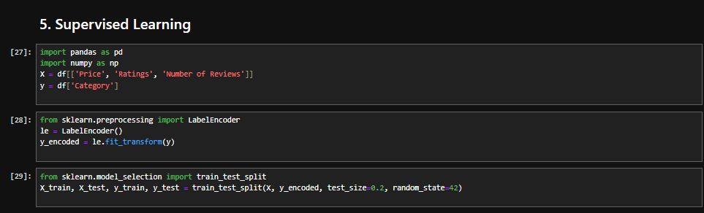
Supervised Learning (Classification)
Apply various classification algorithms to predict product categories or other relevant labels based on features

Slide 15
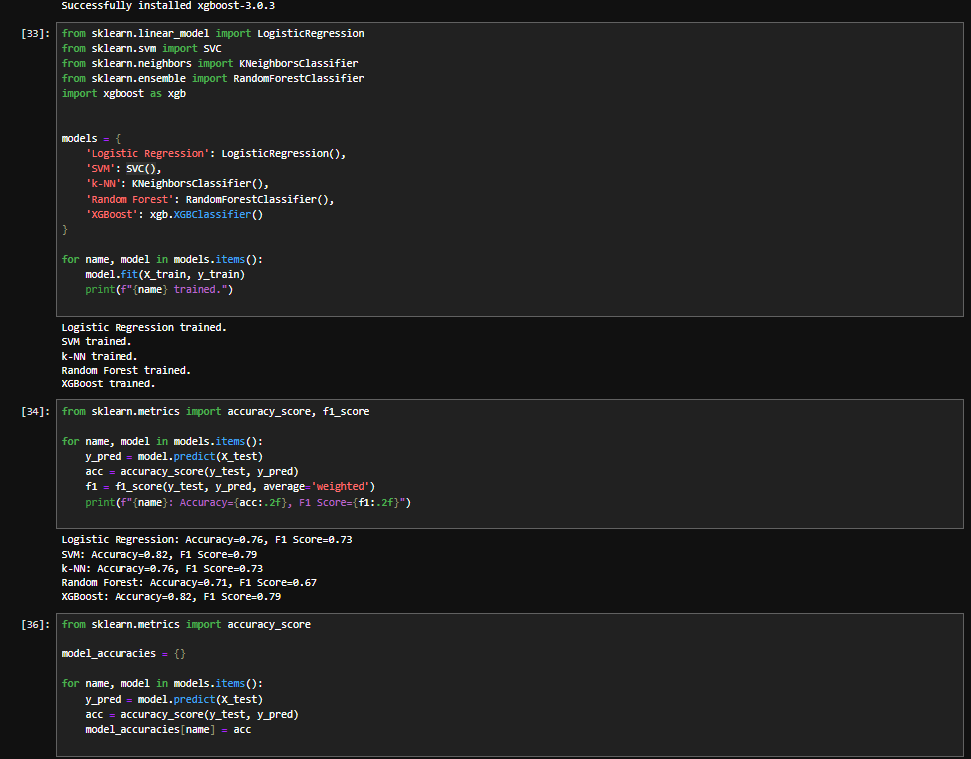

Slide 16
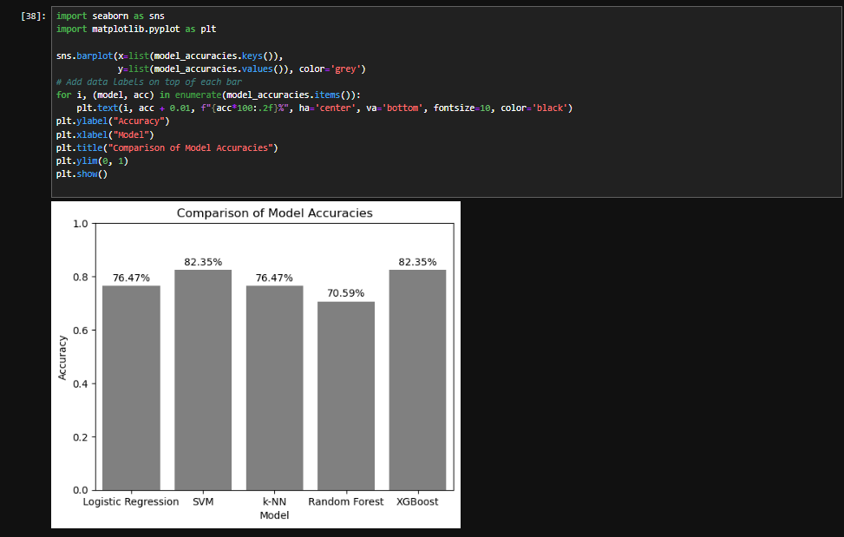

Slide 17
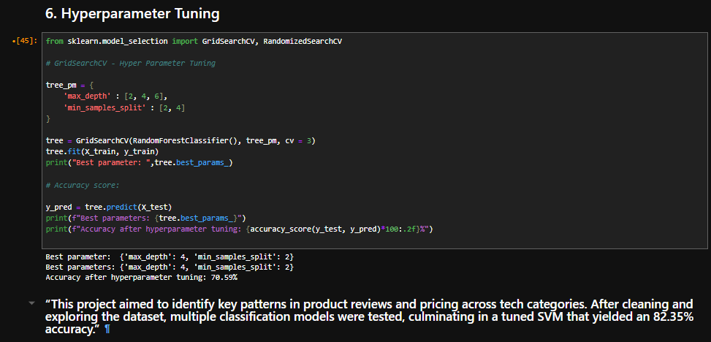
Hyperparameter Tuning

Slide 18

Thank you

